Slide 1
Mess Management System

Slide 2
Scope
The project is an Web based application It would avoid confusion and help operate the software easily. Also, such a software that is easy to use will reduce the work of canteen managers who still maintain all the logs in registers and files.

Slide 3
Objective
Our purpose is to develop a paperless system that provide the management a way to facilitate smoother functioning of the mess system.
This project is used to provide user friendly daily attendance system that is easy to manage, maintain and query.

Slide 4
Motivation
Consisting of most of the students, one of the most massive task of the mess management is to take care of the dining needs of its students.

Slide 5
Design Vision
We knew since the beginning that attending a meal in the mess is a daily routine of students living in a hostel, and thus the app had to be designed in a way that it can resemble the activities and experiences of students in the mess, from marking attendance to getting a meal, etc.

Slide 6
Abstract
The main aim of any canteen/mess/Hotel is to provide clean and fresh food to the students/employees of the organization. In many organizations, entire mess management and billing calculations are done manually till date. It is very time consuming and increases the chances of performing calculation mistakes. It would be possible to do the same work within a short period of time and without using much efforts and manpower if there existed a software for the same. Thus, there arises a need to create a software for the same. Such a software would make the entire Mess related management an automated system.
The software is not only restricted to food items and their billing manipulations, but handling the information of the cadets seeking training in the PTC is also possible in the software. Thus, such a combination in a single software is of great benefits

Slide 7
Introduction
For simplicity and better understanding of the Smart Mess management System, this software is designed in English language.
It would avoid confusion and help operate the software easily. Also, such a software that is easy to use will reduce the work of mess managers who still maintain all the logs in registers and files.
It would be of great benefit as all calculations would be done easily on the click of a button.

Slide 8
Advantages
Less time consuming and faster movement of queues.
Minimization of food wastage.
Staff need not b present at all times at the serving tables.

Slide 9
System Requirement
Hardware Requirements
Name | Specifications
Processor | Intel I5
Ram | Minimum 4GB
Software Requirements
Name | Specifications
Editor | Visual Studio
Operating System | Windows
Server | Apache, MySql

Slide 10
Tools Used
Type : | Web Application
Front End : | HTML, Botstrap, CSS, Javascript
Back End : | JAVa, MySql
Software's Used : | Visual Studio, MySQL Workbench

Slide 11
Features
Displaying the mess menu.
A self-contained system for feedback and suggestions.
Print your whole database which has created automatically.
User will get notifications when any update will be occurred in system.
Security system is available.

Slide 12
APPLICATIONS:-
Data management :- Data management allows customers to add and store information
Student history :- Student history stores information about Food, Timing, Expenses etc.
Food scheduling :- Food scheduling allows students to easily schedule Food, register them, and deliver according to time.

Slide 13
Web-Based Application:-
An Web Based application lets Student to skip the waiting room and get the Food they need wherever they are.
Using an Web Based , students can track the food during delivery.
Student can Filter and sort food according to their need.

Slide 14
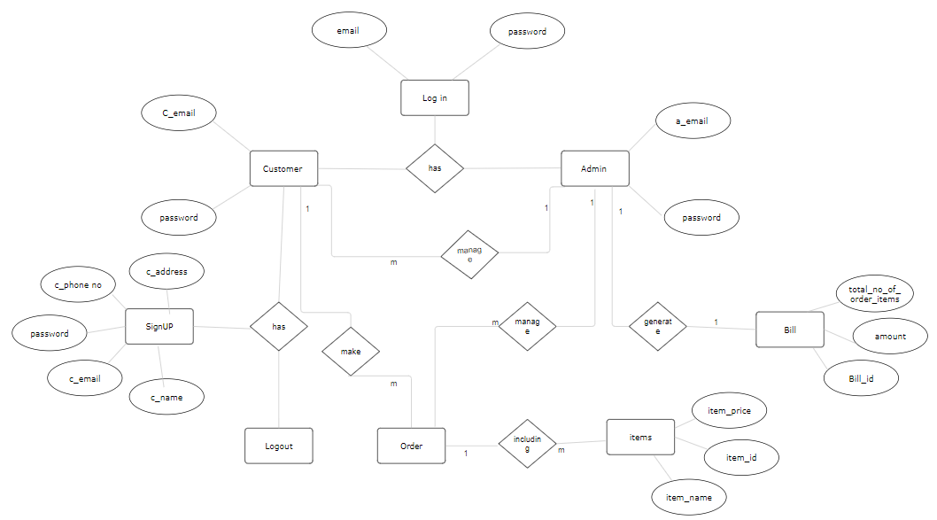
ER-Diagram

Slide 15
Conclusions
Well organized Structure.
Well planned and proper utilization of resources.
Proper ethics being followed.
Ideation encouraged.
Satisfaction

Slide 16
Thank you

